Slide 1

INSTITUTE UIE
DEPARTMENT ACADEMIC UNIT-1
Bachelor of Engineering (Computer Science & Engineering)
Subject Name Semi Conductor Physics
Subject Code 23SPH-143
Prepared By
Dr. Sandeep Kaur
Lecture-2.2.1
Introduction to Optoelectronics Devicses and Photo-Transistor.
DISCOVER . LEARN . EMPOWER

Slide 2
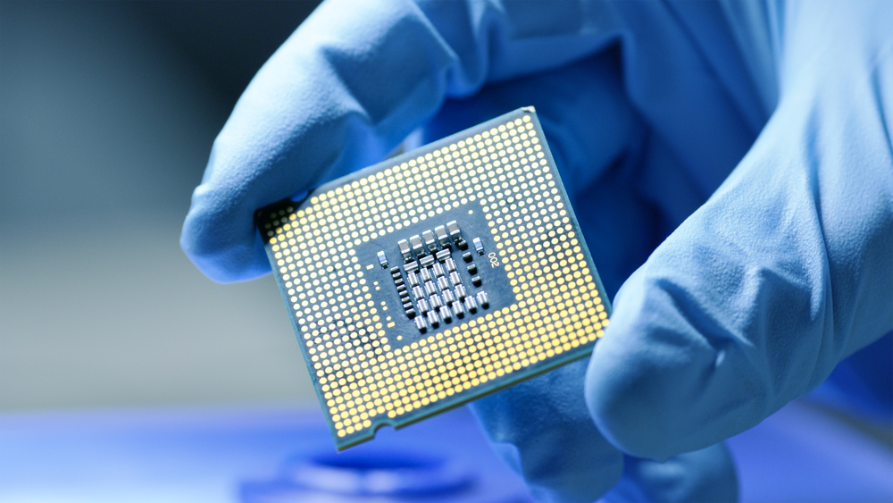
Course Objectives
S. No. | Objectives
1 | To understand the basic materials and properties of semiconductors.
2 | Understand the basic of semiconductor and components like diode, transistor, FET, MOSFET and Energy Sources.
3 | To give knowledge about semiconductor physics and discus working and applications of basic devices, including p-n junctions, BJTs and FETs.
https://www.iqsdirectory.com/resources/everything-you-ever-wanted-to-know-about-semiconductors/

Slide 3
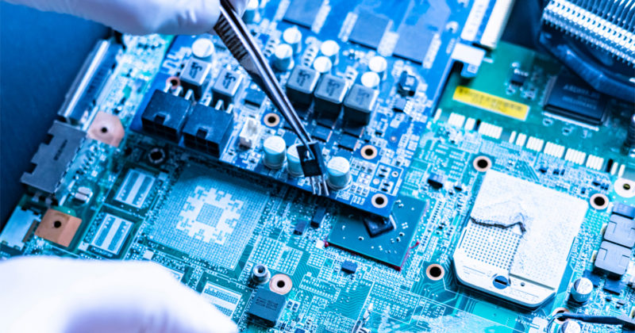
Course Outcomes
S.NO | Description | Blooms’ Taxonomy Level
CO1 | To apply the knowledge of basic semiconductor material physics and understand fabrication processes. | EASY
CO2 | To understand the characteristics of different electronic devices such as diodes, transistors. | MEDIUM
CO3 | To derive the relationships between the parameters in diode, FET, configurations of Transistor and MOSFETs. | MEDIUM
CO4 | To describe the working and design considerations for the various photonic devices like photo detectors, solar-cells and LEDs. | HARD
CO5 | To provide problem solving experience and learning of concepts through it in semiconductor physics. | HARD
https://lot.dhl.com/5-things-the-current-semiconductor-slowdown-tells-us-about-the-global-economy/

Slide 4
Content
Introduction to Optoelectronics
Types of Optoelectronics Devices
APPLICATIONS OF OPTOELECTRONICS DEVICES
PHOTOELECTRIC EFFECT IN SEMICONDUCTORS

Slide 5
An Introduction to Optoelectronics
Optoelectronics is the communication between optics and electronics which includes the study, design and manufacture of a hardware device that converts electrical energy into light and light into energy through semiconductors.
This device is made from solid crystalline materials which are lighter than metals and heavier than insulators. Optoelectronics device is basically an electronic device involving light. This device can be found in many optoelectronics applications like military services, telecommunications, automatic access control systems and medical equipments.

Slide 6
Types of Optoelectronics Devices
Optoelectronics are classified into different types such as
Photodiode
Solar Cells
Light Emitting Diodes
Optical Fiber
Laser Diodes

Slide 7
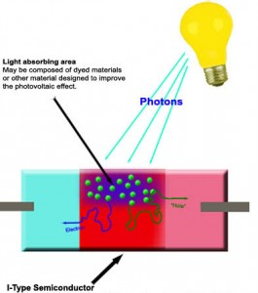
Photo Diode
A photo diode is a semiconductor light sensor that generates a voltage or current when light falls on the junction. It consists of an active P-N junction, which is operated in reverse bias. When a photon with plenty of energy strikes the semiconductor, an electron or hole pair is created. The electrons diffuse to the junction to form an electric field.
Fig.1 Photo Diode

Slide 8
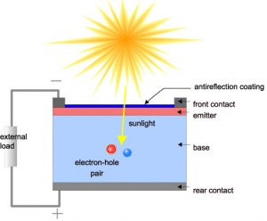
Solar Cells
A solar cell or photo-voltaic cell is an electronic device that directly converts sun’s energy into electricity. When sunlight falls on a solar cell, it produces both a current and a voltage to produce electric power. Sunlight, which is composed of photons, radiates from the sun. When photons hit the silicon atoms of the solar cell, they transfer their energy to lose electrons; and then, these high-energy electron flow to an external circuit.
Fig.2 Solar Cells

Slide 9
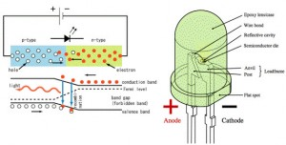
Light-Emitting Diodes
Light-emitting diode is a P-N semiconductor diode in which the recombination of electrons and holes yields a photon. When the diode is electrically biased in the forward direction, it emits incoherent narrow spectrum light.
Fig.3 Light Emitting Diode

Slide 10
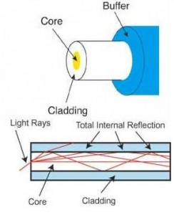
Optical Fiber
An optical fiber or optic fibre is a plastic and transparent fiber made of plastic or glass. It is somewhat thicker than a human hair. It can function as a light pipe or waveguide to transmit light between the two ends of the fiber.
Fig.4 Optical Fiber

Slide 11
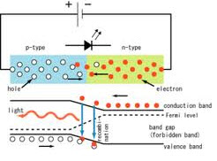
Laser Diodes
Laser (light amplification by stimulated emission of radiation) is a source of highly monochromatic, coherent and directional light. It operates under stimulated emission condition. The function of a laser diode is to convert electrical energy into light energy like infrared diodes or LEDs.
Fig 5. Laser Diodes

Slide 12
APPLICATIONS OF OPTOELECTRONICS DEVICES
Propeller Display of Message by Virtual LEDs
LED Based Automatic Emergency Light
Mains Operated LED Light
Display of Dialed Telephone Numbers on Seven Segment Display
Solar Powered Led Street Light with Auto Intensity Control
Solar Energy Measurement System
Arduino based Solar Street Light
Solar Powered Auto Irrigation System
Solar Power Charge Controller
Sun Tracking Solar Panel

Slide 13
PHOTOELECTRIC EFFECT IN SEMICONDUCTORS
Photoelectric Effect- The photoelectric effect is a material's ability to create an electric voltage or current upon light exposure. PV cells have to be material with the photoelectric effect.
When In the previous page the amount of electrical power potential was explored; this page looks at a much smaller scale where the electromagnetic particles are interacting with objects of relatively small surface area

Slide 14
Photon Interaction with Semiconductors
Semiconductor material has a characteristic called the band gap. The band gap is a measure of energy in electron-volts (eV) or Joules. If a photon comes into contact with a semiconductor the energy level of the photon and the band gap of the semiconductor will determine what will happen next.
When a photon has a lower energy than the semiconductor's band gap it passes through the semiconductor with little effect.

Slide 15
Photoelectric principles
According to quantum mechanics, electrons bound to atoms occur in specific electronic configurations. The highest energy configuration (or energy band) that is normally occupied by electrons for a given material is known as the valence band, and the degree to which it is filled largely determines the material’s electrical conductivity.
In a typical conductor (metal), the valence band is about half filled with electrons, which readily move from atom to atom, carrying a current.

Slide 16
Applications
Devices based on the photoelectric effect have several desirable properties, including producing a current that is directly proportional to light intensity and a very fast response time. One basic device is the photoelectric cell, or photodiode. Originally, this was a phototube, a vacuum tube containing a cathode made of a metal with a small work function so that electrons would be easily emitted.

